Slide 1

Heart Disease Mortality By: Chad Coggins, Evan Robinson, Jordan Johnson-Williams, Maura Tobin, and Yolanda Williams

Slide 2

Introduction
Heart Disease Mortality in the United States
Leading Cause of Death: Heart disease is the leading cause of death for men, women, and people of most racial ethnic groups in the United States.
Impact: Cardiovascular diseases- including coronary artery disease, heart attacks, heart failure, and arrhythmias- are responsible for one death every 33 seconds.
Affected Groups: Heart disease impacts individuals across all backgrounds, including Hispanic, Asian, Black, White, American Indian or Alaska Native, Native Hawaiian or Other Pacific Islander, and more than one race populations.

Slide 3

Key Risk Factors
Lifestyle: Unhealthy diet, smoking, lack of exercise, and excessive alcohol use increase heart disease risk.
Medical Conditions: High blood pressure (Hypertension), high cholesterol, diabetes, overweight and obesity.
Genetics: Family history of cardiovascular diseases can elevate individual risk.
Healthcare Access: Disparities in healthcare access, especially between rural and urban areas can impact heart disease mortality rates.

Slide 4


Dataset
Dataset: Heart Disease Mortality Data Among US Adults 35+ by State/Territory and County (2019-2021).
Source: U.S. Department of Health & Human Services and National Vital Statistics System (NVSS)
Metadata: Accessed via catalog.data.gov
Dataset composition
Time Frame: Data from 2019-2021, presented as a 3 –year average,
Metrics: Age-standardized morality rates for cardiovascular-disease per 100,000 population.
Visualization: Data visualized at state and county levels, with breakdowns by gender and race/ethnicity.

Slide 5
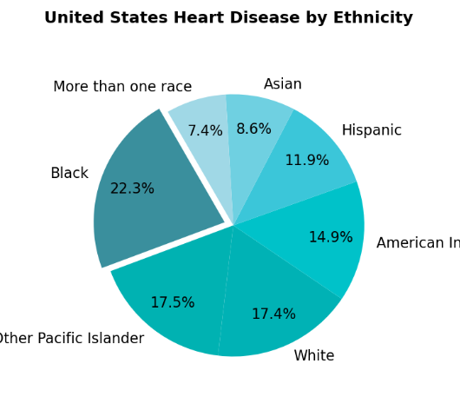
Heart Disease by Ethnicity for Adults Aged 35 and Older
Black Adults: Face a 22.3% higher risk of heart disease compared to other ethnic groups.
White Adults: Experience a 17.4% higher risk of heart disease.
More than one race Adults: Have the lowest recorded risk, at 7.4%.

Slide 6
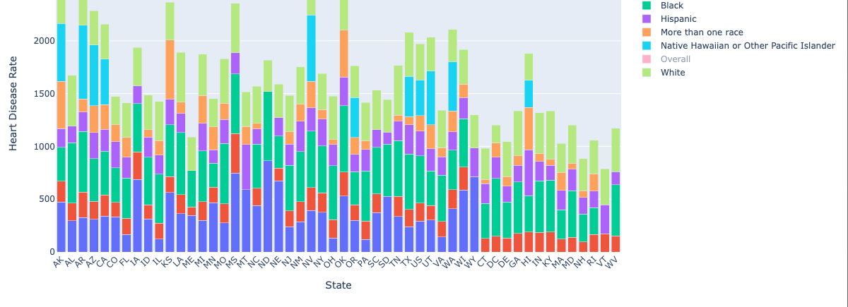
Race and Ethnicity Across U.S.
This bar chart illustrates the heart disease mortality among different race and ethnicity groups across the United States.
Notes:
Jordan

Slide 7
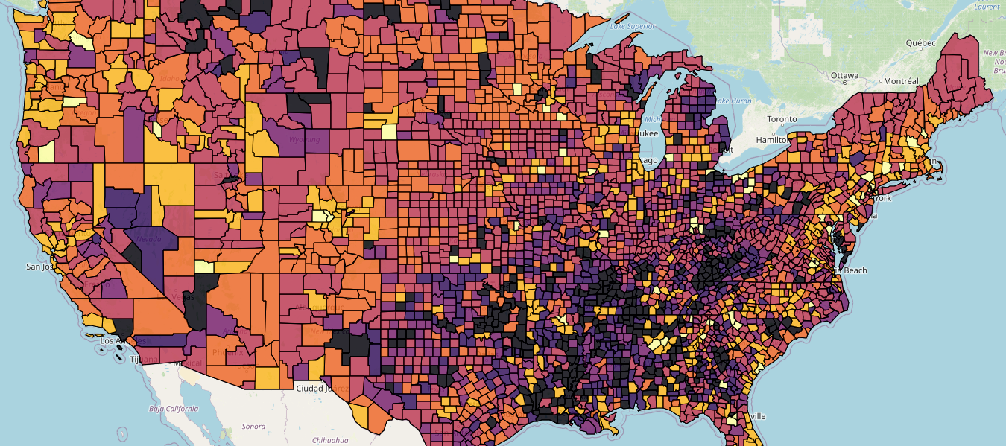
Overall: Heart Disease Death Rates, 2019-2020 for adults, ages 35+ by County.

Slide 8
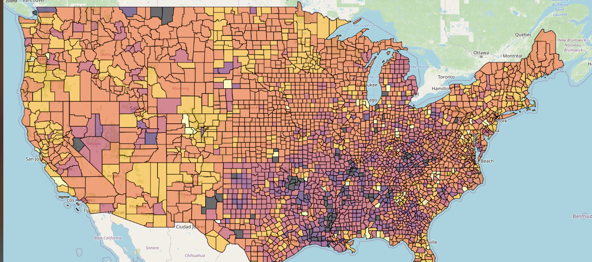
Women: Heart Disease Death Rates, 2019-2020 for adults, ages 35+ by County.

Slide 9
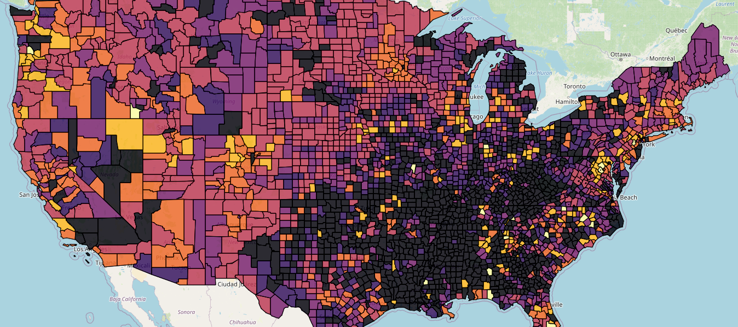
Men: Heart Disease Death Rates, 2019-2020 for adults, ages 35+ by County.
Notes:
Men are more likely than women to report having heart disease.

Slide 10

Conclusion:
Heart disease remains a leading cause of death across diverse populations in the United States, highlighting the critical need for targeted research and intervention.
By understanding the risk factors-such as lifestyle, medical conditions, genetics, and disparities in healthcare access-we can address the needs of those most affected
Ethical considerations in data handling, inclusivity, and advocacy are essential to ensure that research drives positive change and equitable healthcare policies
Through continued awareness, preventative measures, and policy improvements, we can work toward reducing heart disease mortality rates and promoting healthier, longer lives for all.

